Slide 1


Department of Computing
Creating the digital future
The Cyber Security Knowledge Exchange: Working with Employers to produce authentic PBL scenarios and enhance employability.
  Chris Beaumont
  Michael Banford
  Peter Hartley, Visiting Professor

Slide 2
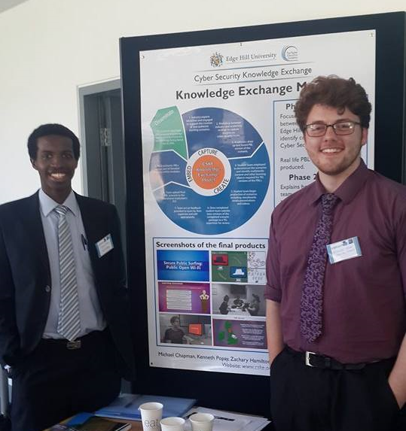
Agenda
Context
CSKE Aims
PBL Scenarios
Knowledge Exchange Placements
Engaging with Employers
PBL/ Consulting Model
Lessons Learned
Notes:
Mention student/alumni same findings so talked about together.

Slide 3

Context
Cybersecurity: the problem – why bother?
UK faces devastating cyber security skills crisis
Cyber Security Ranked Third in Lloyd’s of London Risk Index
SMEs are putting a third of their revenue at risk
80
60
40
20
0
Stock photo: 44677214
Notes:
RATIONALE UK faces devastating cyber security skills crisis
UK faces devastating cyber security skills crisis: By 2017, there will be a global shortage of no less than two million cyber security professionals, warn industry insiders. (Flood, G. 2014).
Cyber Security Ranked Third in Lloyd’s of London Risk Index (Aug 2013)
SMEs are putting a third of their revenue at risk because they are falling for some of the common misconceptions around cyber security, a new report claims. (Telegraph, 2015)

Slide 4
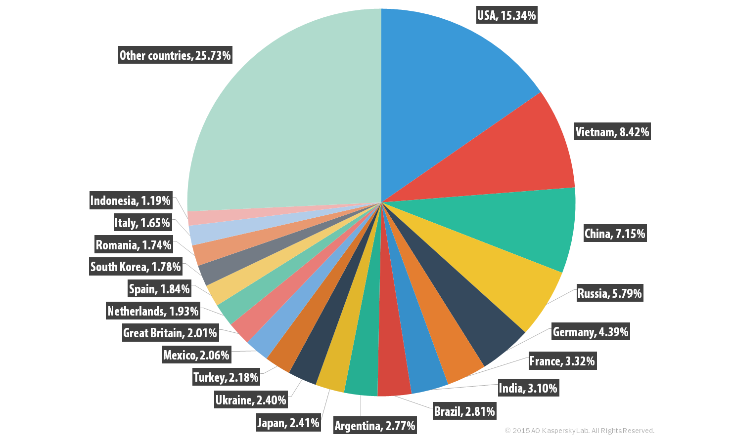
Sources of malicious Spam
Jul-Sept 2015
Notes:
Biggest targets: Germany (18) Brasil (11) Russia(7.5) Ireland < 1.1

Slide 5
Cybersecurity: aims of the Edge Hill project
Responds directly to the UK government’s National Cyber Strategy by:
Creating widely available leading-edge educational resources for industry and HE which develop employability
Increasing SMEs’ cybersecurity expertise.
Increasing the supply and expertise of graduates.
Maximising impact through active dissemination/ promotion

Slide 6
Cybersecurity: components of the project
PBL scenarios:
  Flexible and re-usable Cyber-security scenarios aligned with current best practice. Developed with Industry partners.
MOOC
Knowledge Exchange
  MSc InfoSec Students undertake activities to promote
  Cyber-Security during a placement within an SME.
Model of Engagement
  the evidence-based model, derived from evaluation, enables other HEIs to adopt or adapt it.

Slide 7
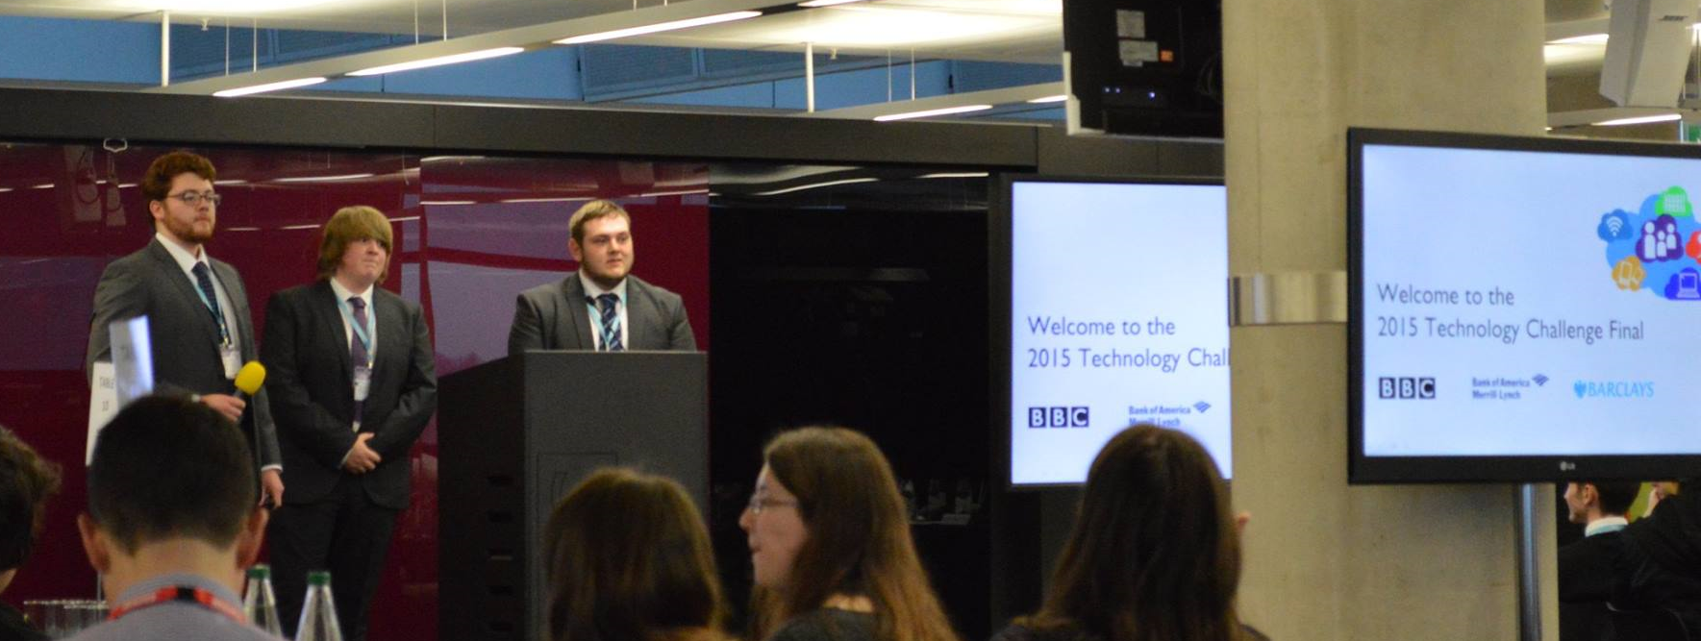
PBL & Employability
How does PBL develop Employability?
  People related skills : Communication, Interpersonal, influencing, Negotiation, Team-working, Leadership,Business & customer awareness
  Conceptualising / thinking skills: Managing information, Problem solving, Planning & organization, Learning skills, Thinking innovatively & creatively, Reflective skills
Skills related to the community: Citizenship skills
Personal skills & attributes: Professionalism and Ethical behaviour, Enthusiasm & positive attitude, Adaptability, Motivation, Reliability, Responsibility, Honesty, Resourcefulness / Determination, Commitment, Flexibility, Time management and working under pressure
Notes:
Knight and Yorke (2003)
employability the result of ‘complex learning’
programme wide experience within a ‘learning culture/environment’
‘a good learning environment’
opportunities for students to mix
collaborative work on problems
students know why (and what) they are learning
USEM Model of employability
Understanding
Skills
Efficacy
Metacognitive fluency
PBL is coherent with this model
PBL characterised by complexity

Slide 8
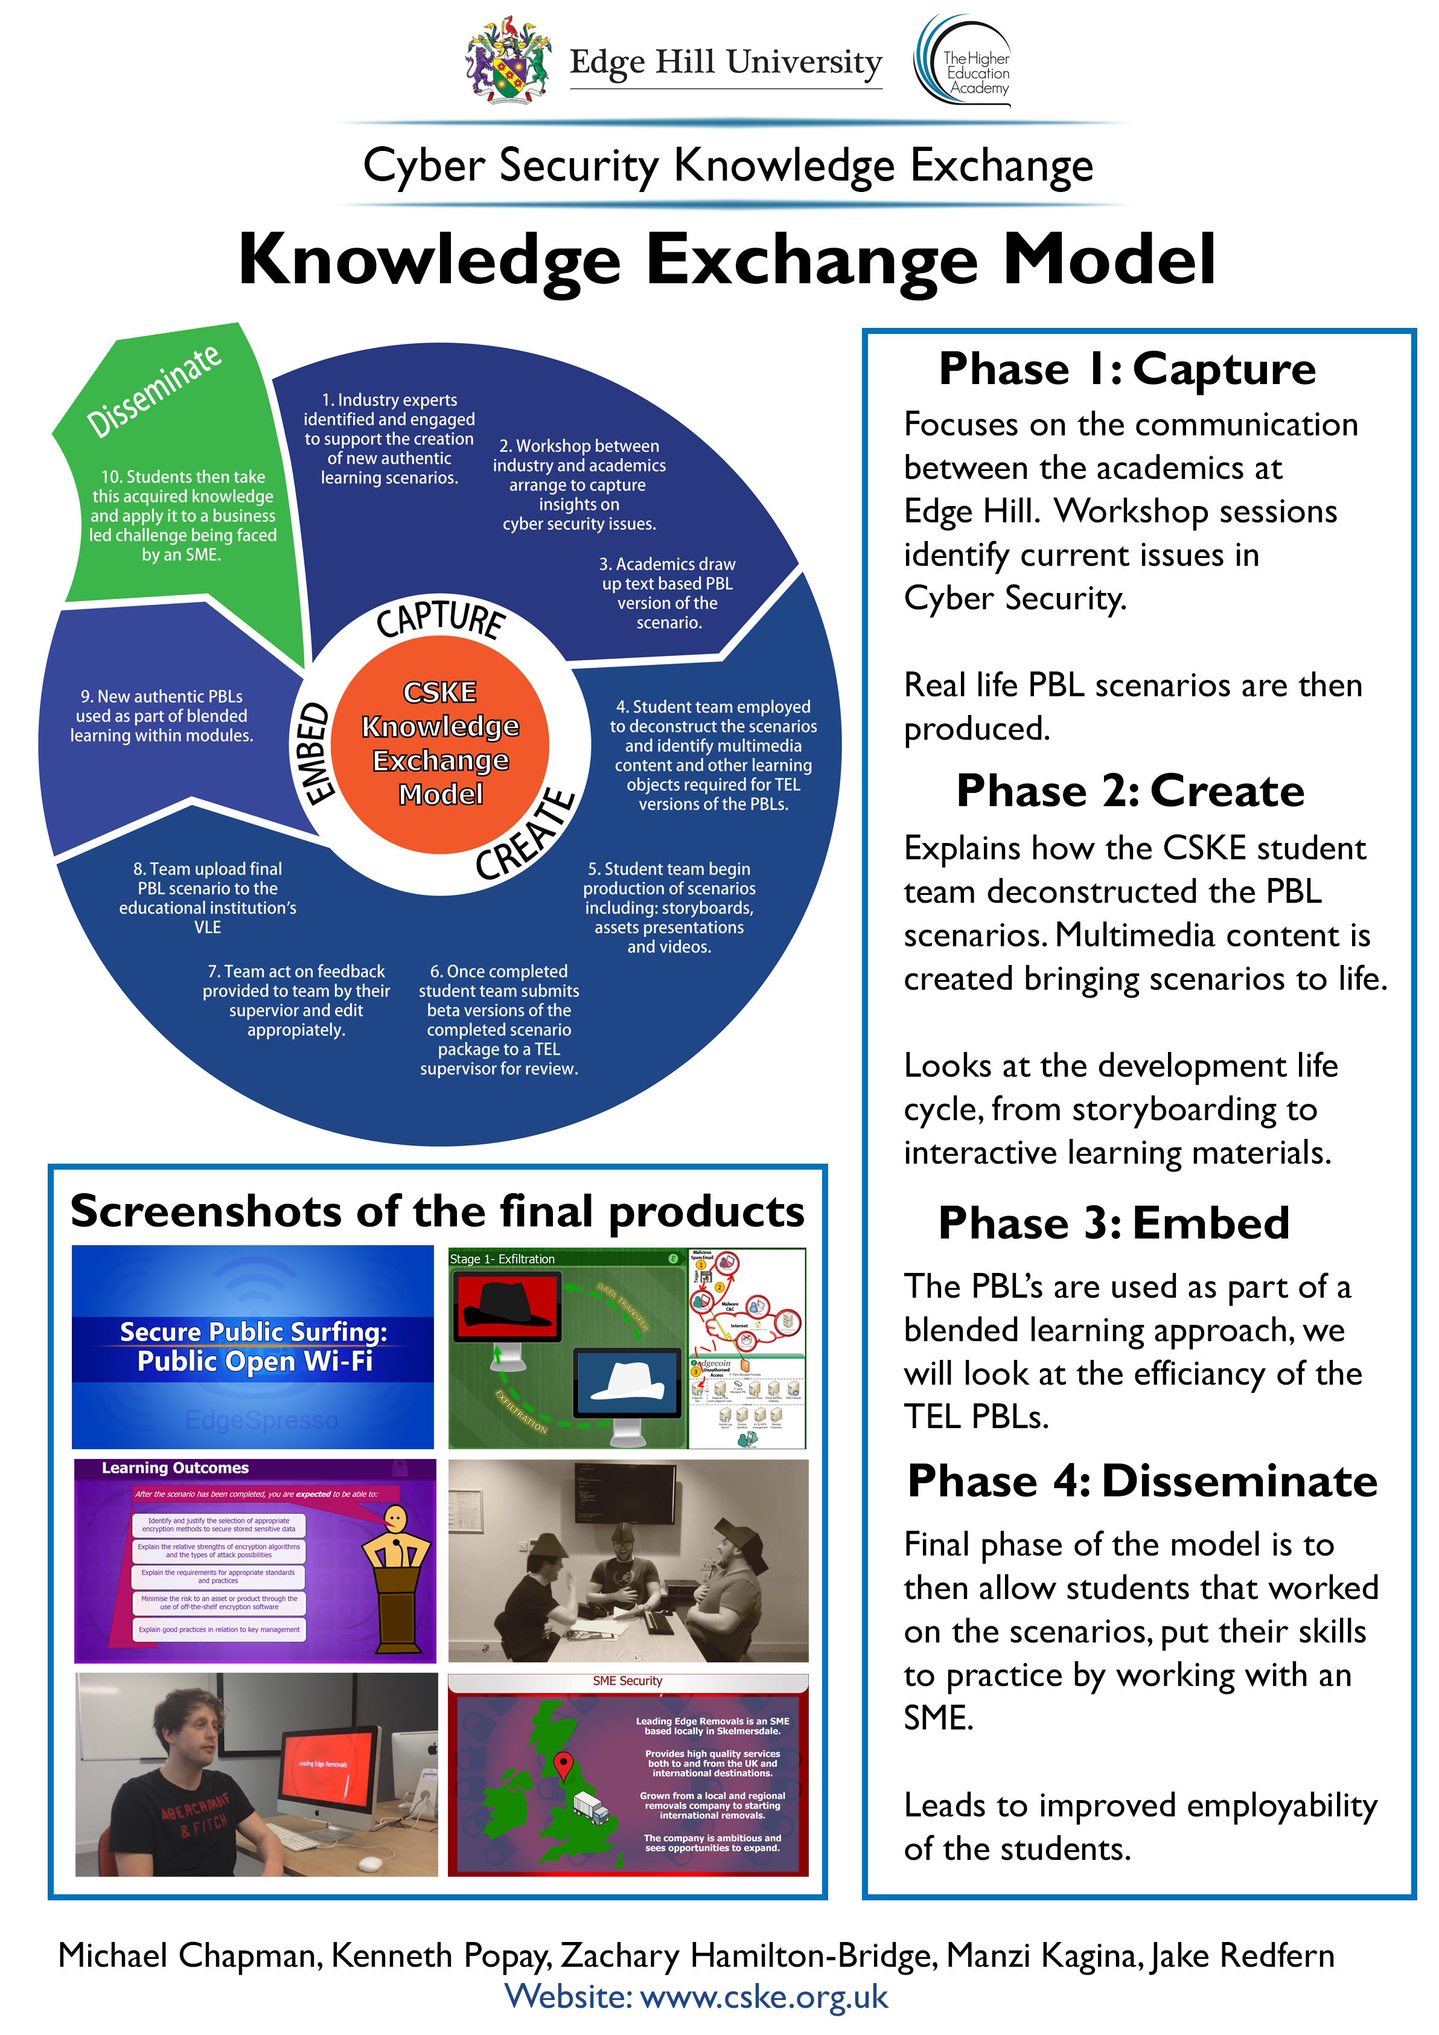
Cybersecurity: progress to date
  9 paper based PBL Scenarios in Draft form
    Incident management, Emergency services, Social Engineering, Data Governance, Secure Development, Cryptography, WiFi Security, Web form attacks, Risk Assessment.
    TEL resources for 6 created
  3 x SME placements identified, 2 completed
    Risk Assessment x 2 ; Penetration test
  MOOC created
  Project web site: www.cske.org.uk

Slide 9
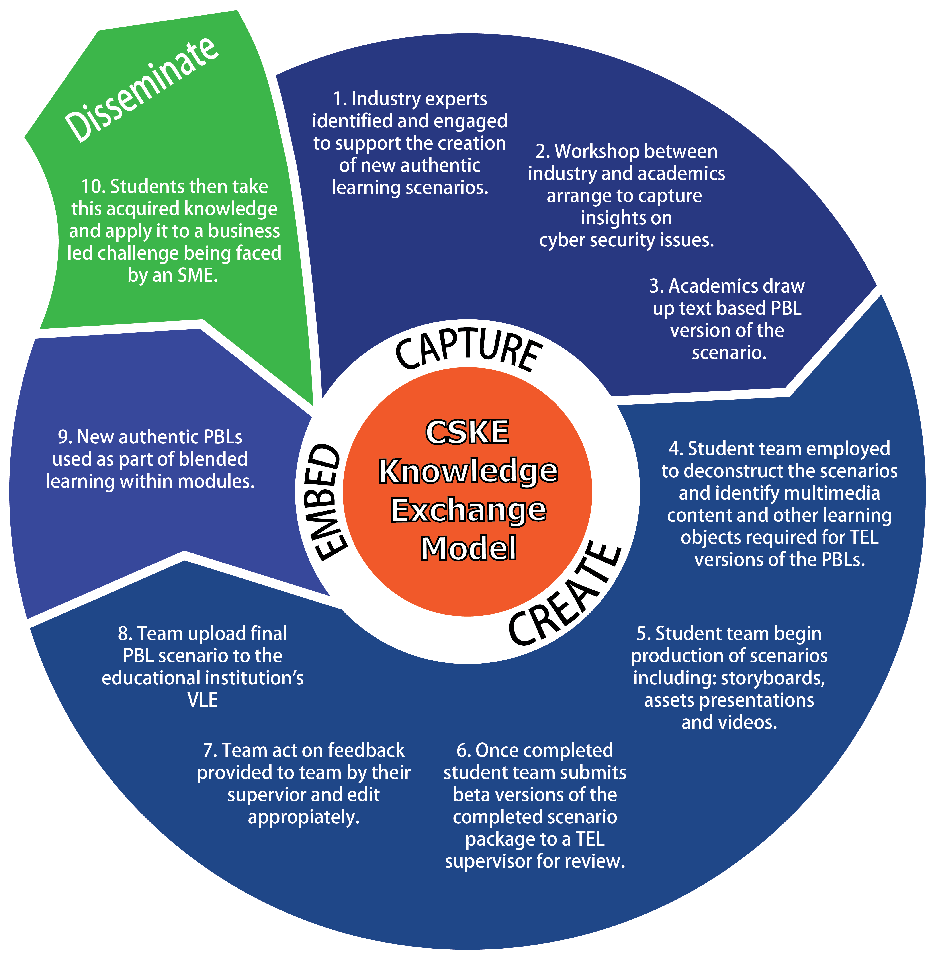
The CSKE Model:
Employers,
Integrating PBL
and Placements

Slide 10
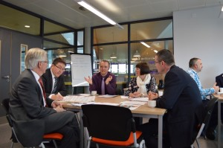
PBL Scenario development
Recruit industry partners
Workshop to elicit knowledge for scenario
Create paper scenario, facilitator guide + resources.
Students develop scripts, video & TEL resources.
Guided by TEL developer

Slide 11
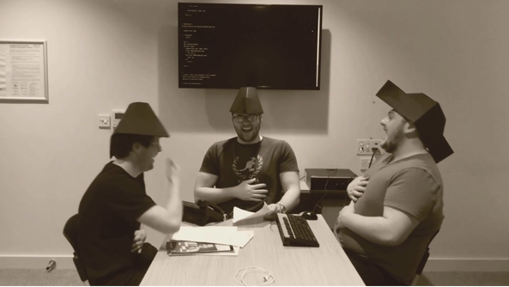
Examples
www.cske.org.uk

Slide 12
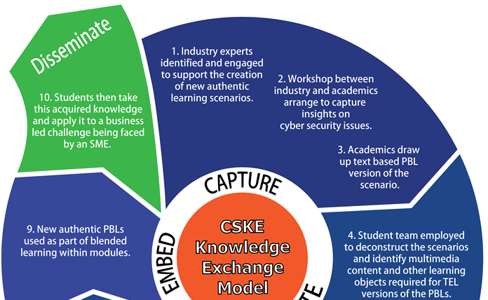
The CSKE Model:
Employers,
Integrating PBL
and Placements

Slide 13
Knowledge Transfer Model
Recruit SMEs
Initial visit to scope the work (student/ Academic/ Project Manager)
Project overview + contract
2 x Students 10 days placement
Deliverables - handover
Notes:
In order to complete this project the following activities will be undertaken:
Review of current information security policy and procedures.
Identification of information and IT assets to create and asset register.
An assessment of the potential threat to these assets and thorough risk analysis.
Formulation of a list of recommended controls and also policies which area aimed at negating identified risks.
Production of training material to allow ULS to disseminate changes to policies and procedures.
Primary deliverables:
Information Security policy and recommendations for contents of procedures.
Information Asset / Risk register, identifying owner, value, threat, impact, likelihood, risk.
A list of recommended controls and also policies which area aimed at negating identified risks.
Recommendations for future development of Information Security Management.
Secondary deliverables.
Production of training material providing an overview of InfoSec policies/ procedures.

Slide 14
E.g. Lancaster based SME
XXX train teachers to deliver literacy teaching using phonics. The company has expanded rapidly over the last 18 months, now delivering in 17 states within Nigeria together with numerous other African states and India
Share data in Dropbox
No policies/ security controls
Laptops/ mobiles/ tablets
Risk assessment required
Recommendations

Slide 15
MOOC
Originally an alternative to PBL scenarios,
Pedagogy of MOOCs…
  Transmission model
  Individual
  MCQ assessment
  Not messy, collaborative, or alternative solutions
PBL & MOOC don’t mix

Slide 16

Staff and Employability
Lessons learned
and future potential
Students’ confidence:
Professionalism
Learning skills/ knowledge
Creativity
Reliability
Ownership
..and value as partners
Notes:
60% confident to promote employability. But: 40 % are not …
Some staff discussed employability in terms of transferable skills and their effect, whilst others felt employability skills were more specific to their subject area. This lack of consistency may in part be responsible for students’ confusion over graduate attributes.
Over half of all staff indicated a need for staff training, but could not give a precise indication in what area. Evidence also suggests training should also be used to assist those that do not have experience beyond academia, to see employability as a core function and to provide a holistic view of the employability skills required by employers- it was suggested that staff should undertake industrial work placements on a rolling rota basis .

Slide 17
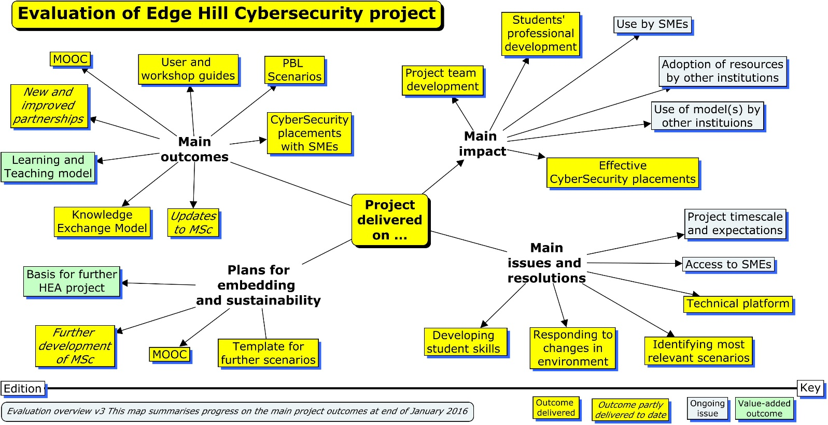

Slide 18
Successes
  Effective collaboration across roles (academics, technologists etc.)
  Increasing student engagement and involvement in curriculum development.
  Curriculum model encourages student exploration and creativity.
  Flexible curriculum model so we can extend the application.
    Cater for current and likely mobile environments.

Slide 19

Difficulties: working with industry partners
Challenging in timescale
Knowledge elicitation was difficult,
  Different partner perspectives and expectations
  Differing levels of knowledge of the proposed cases
Some scenarios not possible. Alternatives created through follow-up meetings with partners.
  Lesson: Specify more fully in advance with partner and further discussion with prospective partners to clarify their expectations and assumptions

Slide 20

Difficulties: limited response from SMEs
The response from SMEs has not been as strong as we expected
  seems to be due to the economic pressures they are facing and the complexity of the sector.
Lesson: Need to spend more time building relationships with SMEs in the next stages of the project

Slide 21
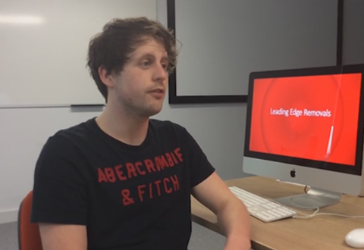
Difficulties:
Flexibility of PBL scenarios
Draft PBL scenarios were not in consistent format, reflecting the variety of situations and different partner perspectives
Lesson: A more detailed learning model had to be developed by the project team
  now been applied to the PBL scenarios to ensure both consistency and flexibility

Slide 22
Summary: How does it stack up?
Responds directly to the UK government’s National Cyber Strategy by:
Creating widely available leading-edge educational resources for industry and HE which develop employability
Increasing SMEs’ cybersecurity expertise.
Increasing the supply and expertise of graduates.
Maximising impact through active dissemination/ promotion

Slide 23
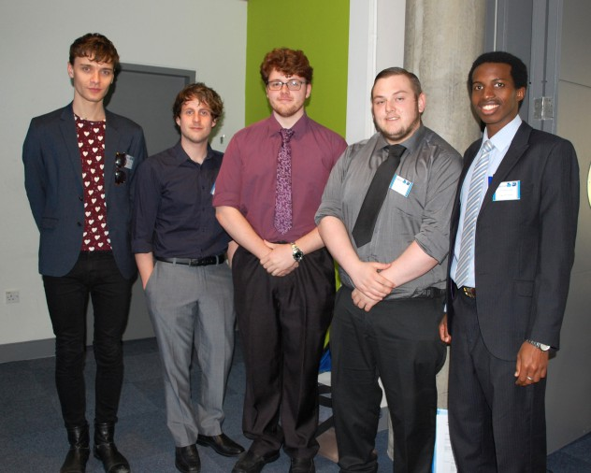

Questions, Comments, Insults?
Dr Chris Beaumont
Chris.Beaumont@EdgeHill.ac.uk
www.cske.org.uk
Michael Chapman, Jake Redfern
Kenneth Popay, Zach Hamilton,
Manzi Kagina,

